Slide 1



Slide 2
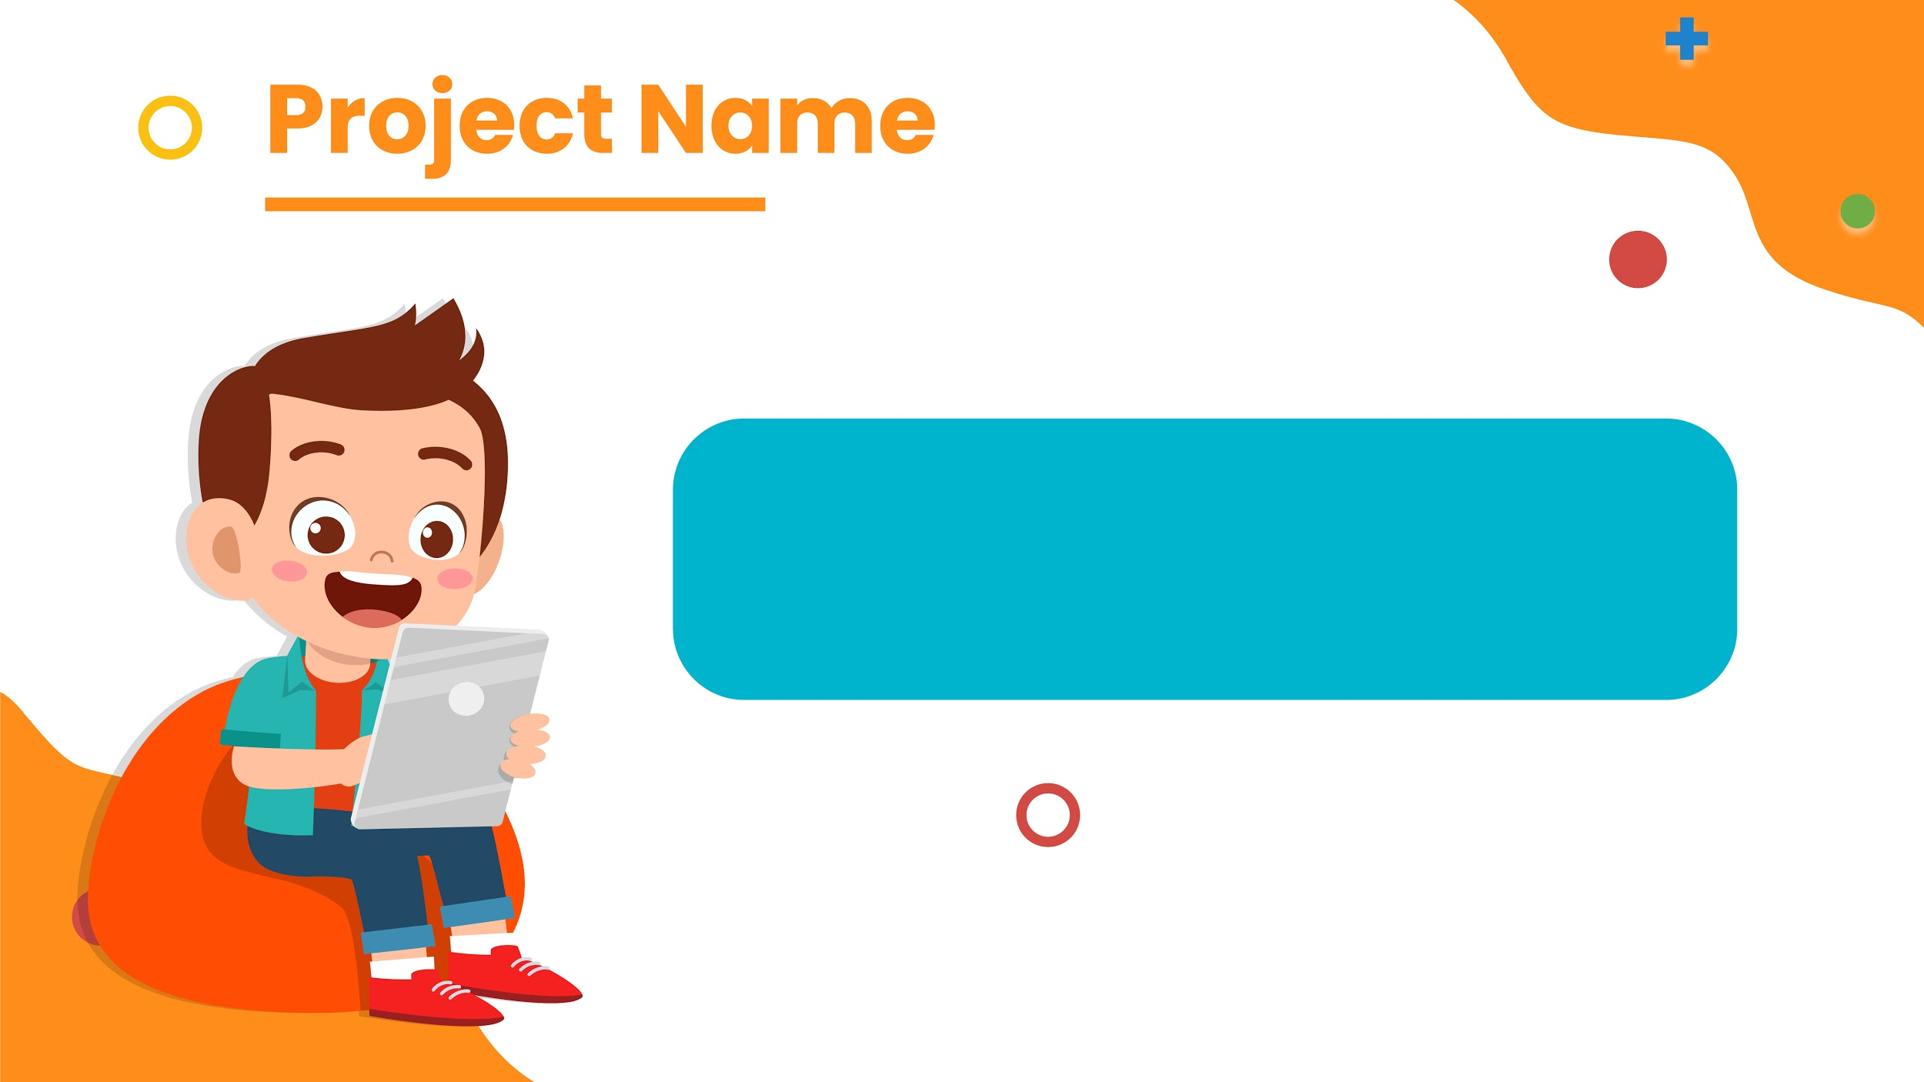
The Jewel Thief

Slide 3
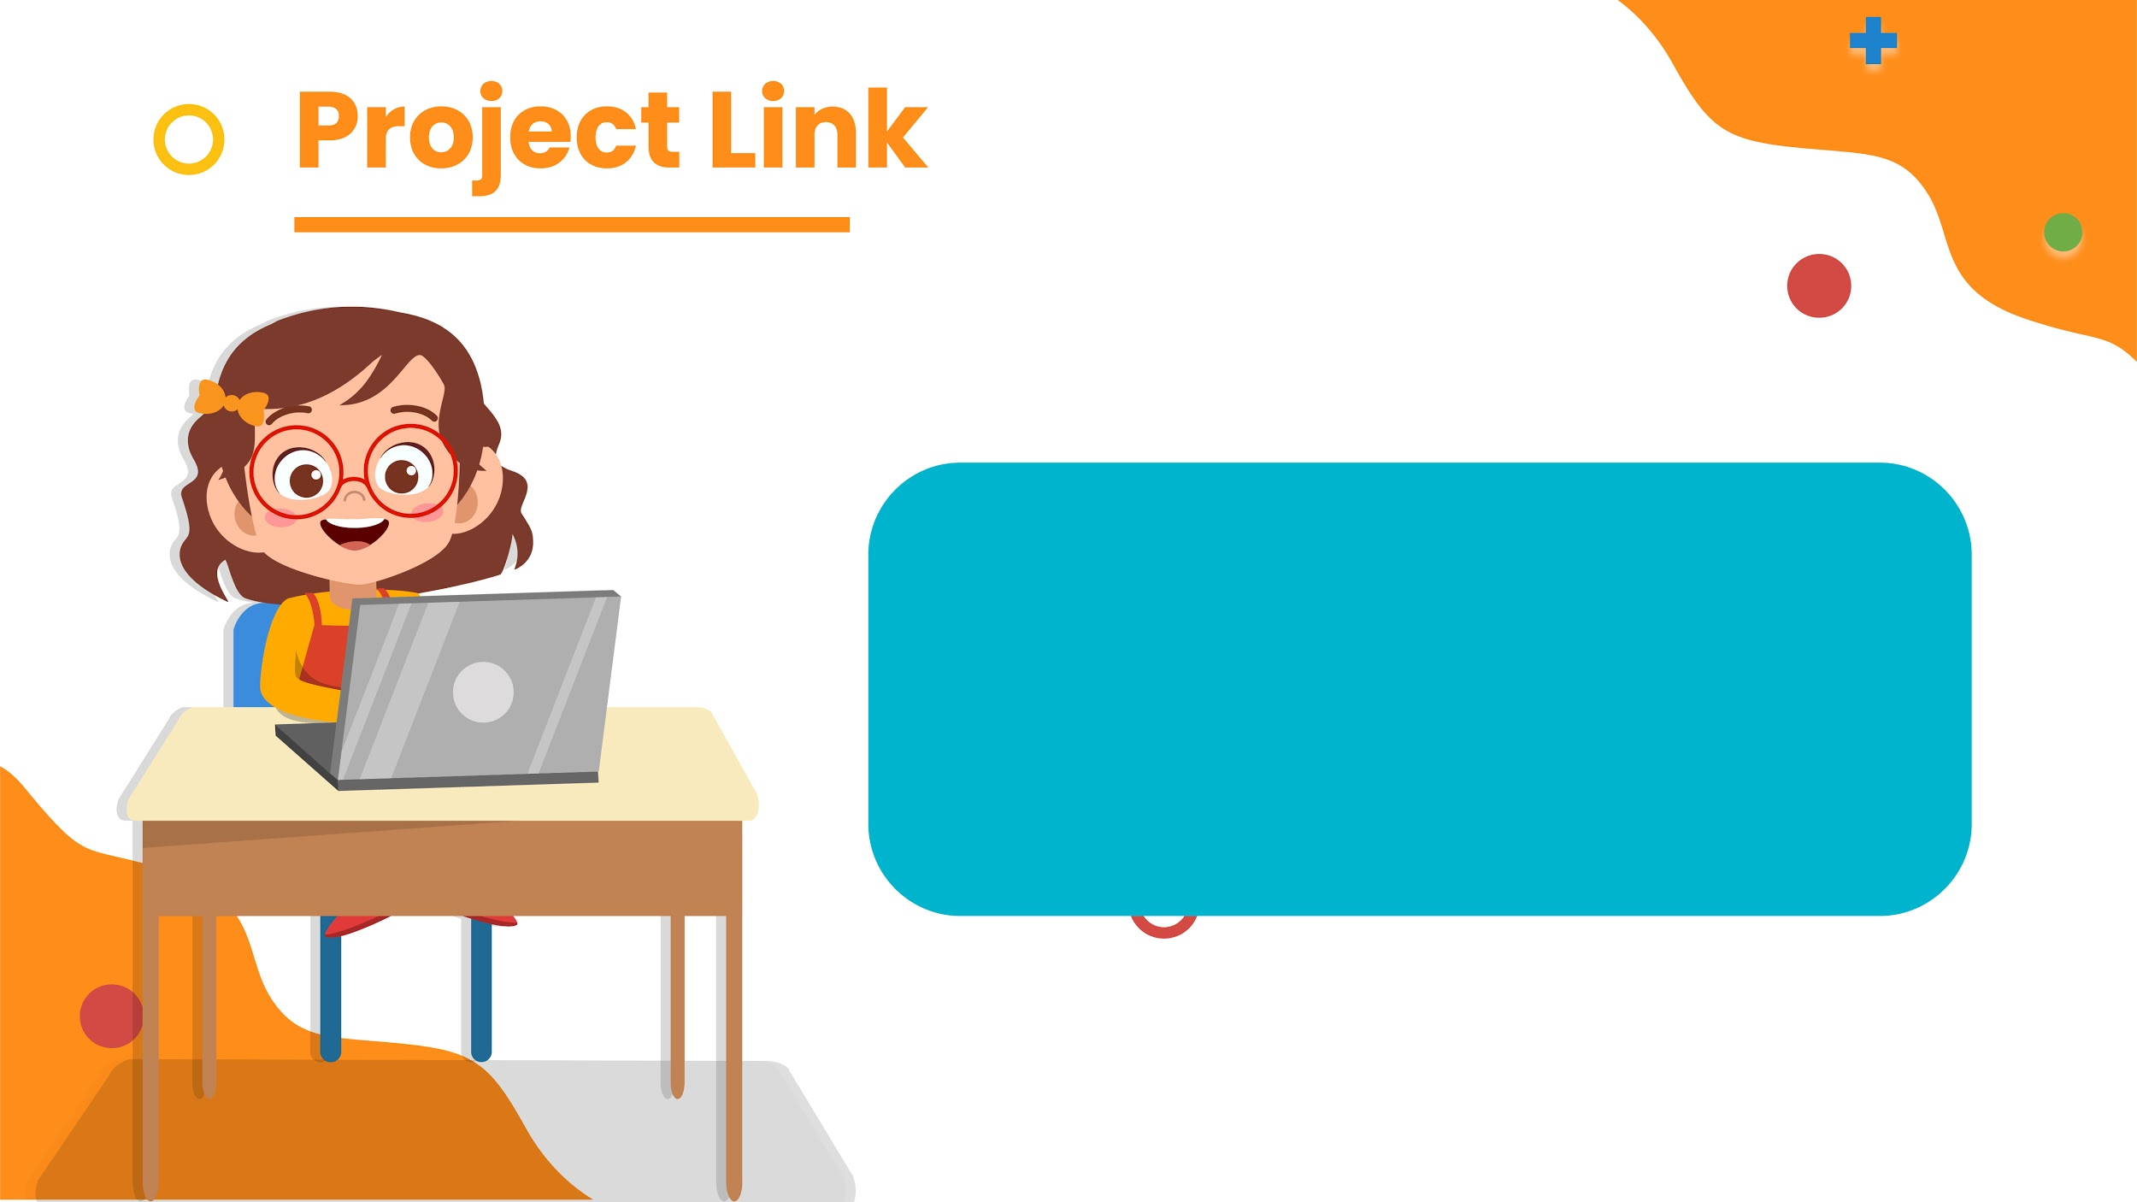
https://studio.code.org/projects/gamelab/d0E-MxggCs9vQx3qyF17ynvN4FiPxKRVNx6wJHGvBnw

Slide 4
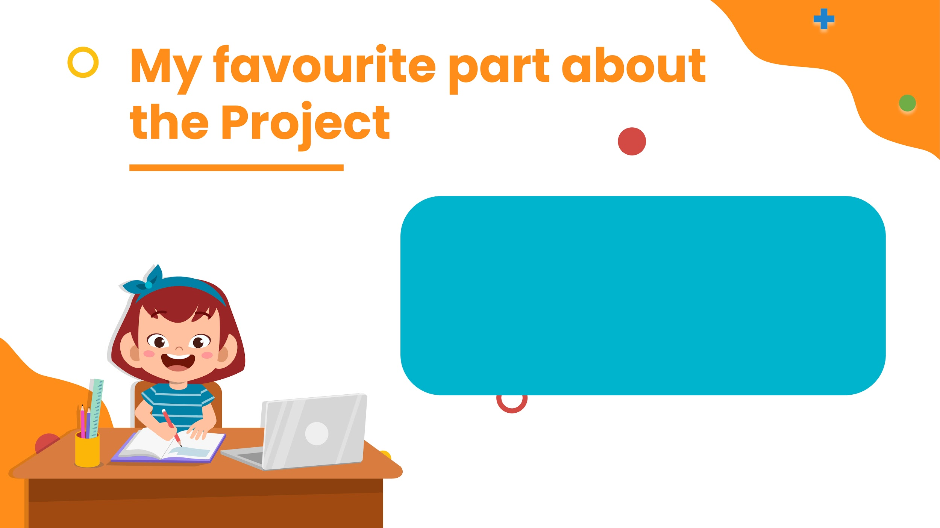
My favorite part of the project was making it , as it is an impossible to win game , it was fun to make it.
I loved adding the color to the sprites.

